Slide 1
Internet Of Behavior
Chandni Kumari
Notes:
We designed this template so that each member of the project team has a set of slides with its own theme. Members, here’s how you add a new slide to just your set:
Mark where you want to add the slide: Select an existing one in the Thumbnails pane, click the New Slide button, then choose a layout. The new slide gets the same theme as the other slides in your set.
Careful! Don’t annoy your fellow presenters by accidentally changing their themes. That can happen if you choose a different theme from the Design tab, which changes all of the slides in the presentation to that look.

Slide 2
Agenda
What Is Internet of Behavior (IoB)?
Applications
Benefits of IoB
Future
Limitations

Slide 3
What is IOB?
The Internet of Behaviour refers to the gathering of data that offers important information on client behaviours, interests, and preferences (IoB).
Internet of behaviour is an extension of IoT.

Slide 4
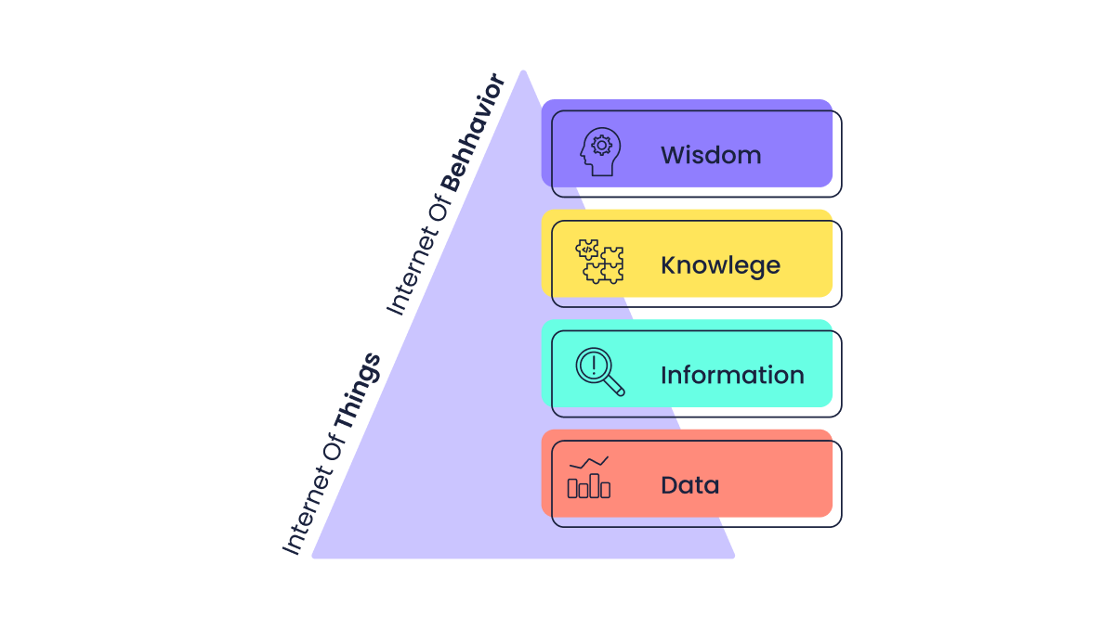
IoB & IoT
IoT works with data, information, and connectivity of different devices with each other
IoB works with these same parameters, adding user behaviors, to understand patterns and impressions that determine the user experience.

Slide 5
Applications
Swiggy and Zomato, for example, both exhibited and promoted restaurant safety procedures. They also recorded and broadcast the temperature of the delivery person to reassure consumers that they were safe.
In relation to transportation, Uber, for example, uses IoT data on drivers, passenger locations and preferences to reinvent CX.

Slide 6
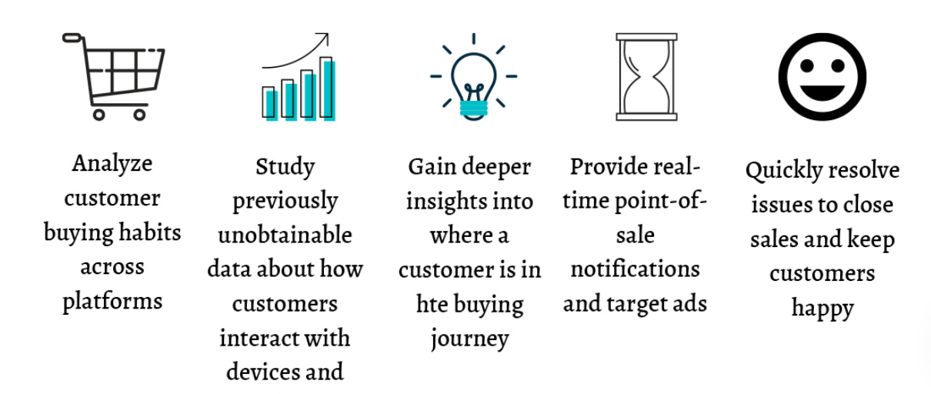
Benefits of IoB

Slide 7
Future
According to Gatner, the technology may still be in its early days, but by the end of 2025, more than 50% of the world’s population will be exposed to at least one IoB programme, either from the government or a private company. It will be the ecosystem that defines human behaviour in an increasingly digital world.

Slide 8
Limitations
Security and privacy
Connectivity and power dependence
Time-consuming and expensive to implement

Slide 9
Thank You

